Slide 1





SQL Music Store Analysis
PostgreSQL
Advanced SQL
Business Intelligence
SQL-driven exploratory analysis of a digital music store using PostgreSQL
By Manohar K

Slide 2

Table of Contents
01
02
Project Overview & Objectives
Dataset & Database Schema
03
04
Tools & Technologies Used
Technology Stack
05
06
Key Business Questions
Key Business Insights
07
08
SQL Analysis Approach
Advanced SQL Techniques
09
10
Key Insights & Findings
Project Goals Achieved
11
12
Challenges & Learnings
Key Takeaways
13
Conclusion & Next Steps

Slide 3

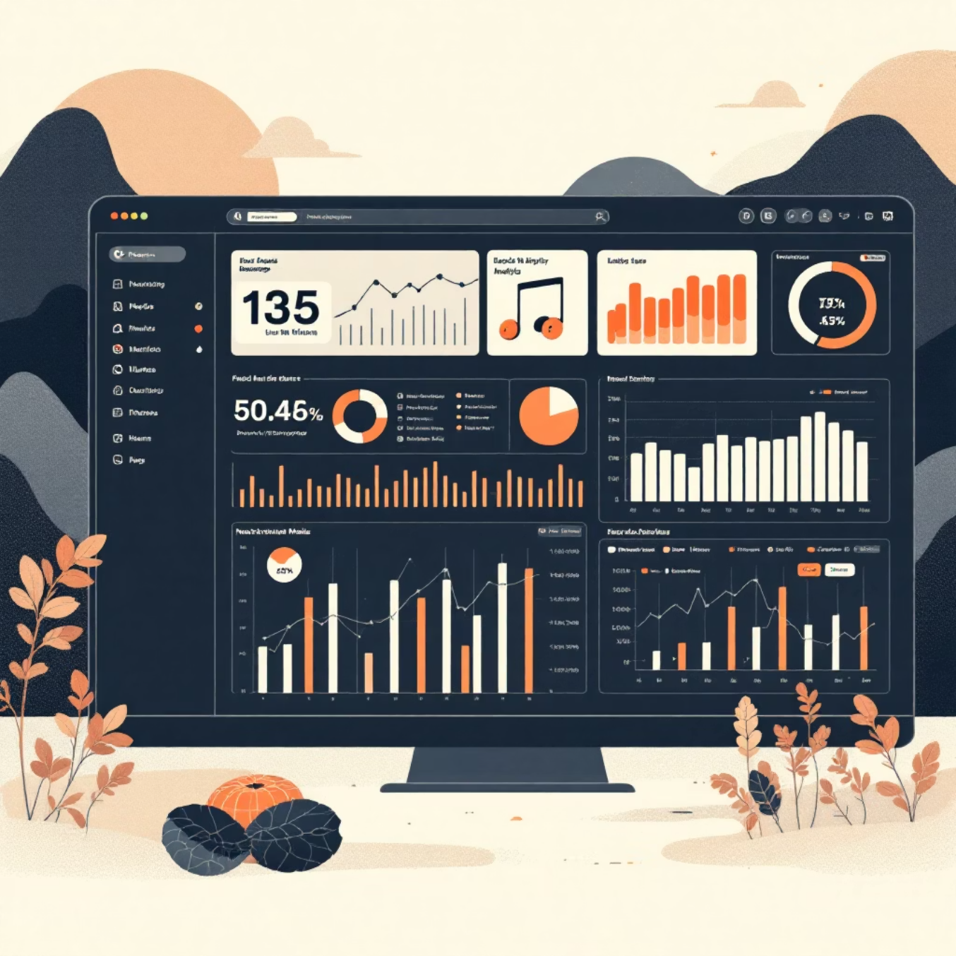
PORTFOLIO PROJECT
Project Overview
This project analyzes a complete digital music store database encompassing customers, artists, albums, tracks, and sales transactions. Using PostgreSQL, I performed comprehensive exploratory data analysis to extract actionable business insights.
The analysis demonstrates proficiency in advanced SQL techniques including complex joins, aggregations, window functions, and CTEs. Through 12 real-world business questions, this portfolio-ready project showcases practical data analytics skills that directly translate to business value.

Slide 4






Dataset Overview
Integrated Tables
Artists & Albums
Complete music store operations data
Metadata, catalog management, attribution
Customer & Sales
Normalized Schema
Transaction history and customer profiles
PostgreSQL relational optimized relationships

Slide 5





Database Schema
Core Entities
CUSTOMER
Customer profiles, contact information, and geographic location data
INVOICE & INVOICE_LINE
CUSTOMER
TRACK
Sales transactions with totals, dates, and detailed line-item purchases
INVOICE
INVOICE_LINE
TRACK, ARTIST & ALBUM
Complete music catalog with song metadata, duration, genre, and artist attribution
Supporting Tables
GENRE, MEDIA_TYPE, and PLAYLIST provide organizational structure

Slide 6

QUESTIONS 1-4
Business Analysis: Operational Insights
Q1: Senior Leadership
Q2: Market Distribution
Identified the senior-most employee by analyzing job title hierarchy to understand organizational structure and reporting chains.
Analyzed invoice counts by country to identify key markets and concentrate marketing resources in high-volume regions.
Q3: Peak Revenue Transactions
Q4: Festival Location Planning
Discovered top 3 invoice values to understand high-value purchase patterns and premium customer behavior.
Determined which city has the best customers by total spending to optimize promotional music festival placement.

Slide 7

QUESTIONS 5-8
Business Analysis: Customer & Content
Q5: VIP Customer Identification
Q6: Rock Music Segment
Identified the best customer by total spending to enable targeted retention strategies and personalized engagement.
Extracted all Rock music listeners with email and name for genre-specific marketing campaigns and promotions.
Q7: Artist Collaboration Targets
Q8: Extended Content Discovery
Ranked top 10 rock bands by track count to identify prolific artists for potential exclusive partnerships.
Found tracks longer than average song length to curate specialized playlists for listeners seeking extended listening experiences.

Slide 8

QUESTIONS 9-12
Business Analysis: Revenue & Trends
Q9: Genre Revenue Analysis
Q10: Artist Profitability
Analyzed genres by total revenue and units sold to understand which musical categories drive the most business value.
Calculated artist revenue by genre to identify the most profitable artist-genre combinations for strategic catalog expansion.
Q11: Emerging Genre Trends
Q12: Cumulative Revenue Growth
Identified top genres with year-over-year growth to spot emerging trends and allocate resources to high-potential categories.
Calculated cumulative revenue over time to visualize business growth trajectory and identify peak performance periods for strategic planning.

Slide 9

Key Takeaways
Real-world Data Analysis
Actionable Business Intelligence
Advanced SQL Mastery
Demonstrated practical skills in extracting, transforming, and interpreting data from a complex music store database.
Proficiently applied advanced SQL techniques including complex joins, subqueries, CTEs, and window functions.
Translated raw data into strategic insights, identifying key markets, customer behavior, and revenue trends.
Drives Strategic Decisions
Foundation for Growth
Provided data-driven recommendations for marketing, content strategy, and operational efficiency.
Built a strong foundation for tackling more complex data science and advanced analytics challenges.

Slide 10






Project Goals Achieved
Analyzed 10 Tables
Answered 12 Questions
Advanced SQL Proficiency
Successfully navigated and integrated data from 10 interconnected database tables.
Provided data-driven answers to 12 complex business questions with SQL.
Demonstrated mastery of advanced SQL techniques and functionalities.
Actionable Insights
Portfolio-Ready Analysis
Extracted practical, data-driven business insights for strategic planning.
Developed a comprehensive, professional, and presentation-ready data analysis.

Slide 11






Tools & Technologies Used
PostgreSQL
Advanced SQL
Data Analysis
Powerful open-source relational database management system for storing and managing music store data.
Employed complex queries, joins, aggregations, window functions, and CTEs for in-depth data extraction and manipulation.
Used various analytical methods to uncover trends, patterns, and insights from the music sales and customer data.
Data Visualization
Git & GitHub
Tools for creating clear and impactful visual representations of findings for stakeholder communication.
Utilized for version control, collaboration, and showcasing the project's codebase and documentation.

Slide 12

Advanced SQL Techniques
Complex JOINs
Window Functions
Common Table Expressions (CTEs)
Leveraging INNER, LEFT, RIGHT, and FULL OUTER JOINs to efficiently combine data across multiple relational tables.
Applying ROW_NUMBER(), RANK(), and DENSE_RANK() for intricate analytical queries, enabling calculations across specific partitions of data.
Utilizing WITH clauses to modularize complex queries, improving readability and facilitating recursive operations.
Aggregation Functions
Subqueries & Nested Queries
Employing SUM(), COUNT(), AVG() in conjunction with GROUP BY and HAVING to summarize and filter grouped data effectively.
Constructing queries within queries to perform conditional filtering and derive data based on intermediate results.

Slide 13




Key Business Insights
High-Value Content
Customer Segmentation
Strategic Market Focus
Rock and Metal genres, alongside specific top artists, consistently drive the highest revenue and track sales, indicating strong demand in these segments.
Identified VIP customers through spending patterns, revealing a preference for longer tracks and specific artists, crucial for targeted retention strategies.
Analysis of invoice counts highlighted key geographic markets and top-spending cities, optimizing resource allocation for marketing and festival planning.
Growth Trajectories
Significant revenue growth observed in Q4, confirming seasonal peaks, and an overall upward trend in cumulative revenue underscores business expansion.

Slide 14





Let's Connect
Manohar K
Email
LinkedIn
GitHub

Slide 15

SQL Music Store Analysis
Thank you!

